Slide 1
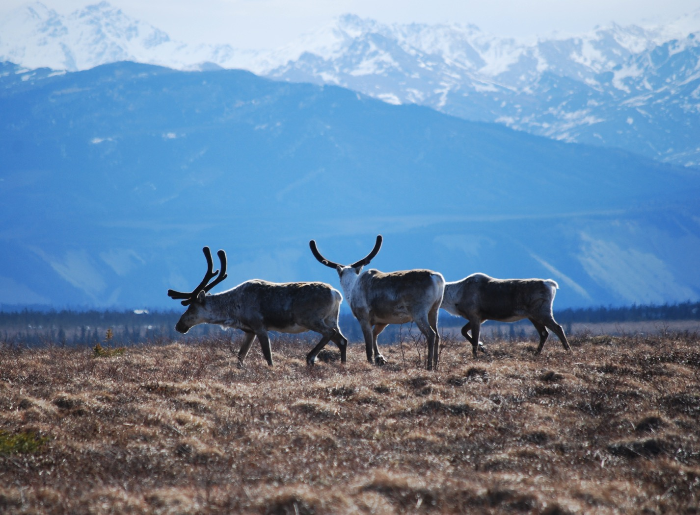
Arctic Boreal Vulnerability Experiment (ABoVE)
2017 ABoVE Airborne Campaign
27 May 2017 (DOY 147)
AirMOSS: Yukon-Kuskowim Delta
Charles Miller, Deputy Science Lead
Jet Propulsion Laboratory, California Institute of Technology
and the ABoVE Science Team For Hank Margolis, Eric Kasichke, Bruce Tagg
NASA HQ
May 2017

Slide 2
27 May 2017/DOY 147 Yukon – Kuskokwim Delta
Assets Deployed:
Fairbanks (PAFA) – AirMOSS (P-band SAR)/JSC G-III (N992NA)
Pilots: Tom “T-Rex” Ryan, Scott “Bonz” Reagan, Tom “Duster” Parent
Science Coordinator: N Pinto
Science Lead: M Moghaddam
Project Manager: Y Lou
Mechanics: Johnny Scott, Jim Fennel
Operators: Phil Vaughn, Dave Elliot, Rocky Smith, Roger Chao, Joanne Shimada

Slide 3
27 May 2017/DOY 147 Yukon – Kuskokwim Delta
Daily Summary:
Science Flight
Successfully flew lines 2, 3, 4, 5 of PLAN_1114 (lines 1 and 6 already flown yesterday)
Successfully flew lines 1, 6, 10 of PLAN_1116 (legacy permafrost lines)
Line 2 of PLAN_1116 also started as a bonus after line 1 but radar reset ~75% into the line; will capture on previously planned sortie (29 May)
No PPA problems
Clouds throughout; no major precip
Kasischke and Chen in the field at Delta Junction
Bonz’ last AirMOSS flight before he retires this Wednesday!

Slide 4
27 May 2017/DOY 147 72-Hour Look Ahead
All plans weather dependent
Sunday 28 May 2017 (DOY 148):
Down Day
Monday 29 May 2017 (DOY 149):
Seward Peninsula
https://uavsar.jpl.nasa.gov/cgi-bin/report.pl?planID=PLAN_1116_v02#flightPlan
Tuesday 30 May 2017 (DOY 150):
North Slope
https://uavsar.jpl.nasa.gov/cgi-bin/report.pl?planID=PLAN_1117_v01#map

Slide 5
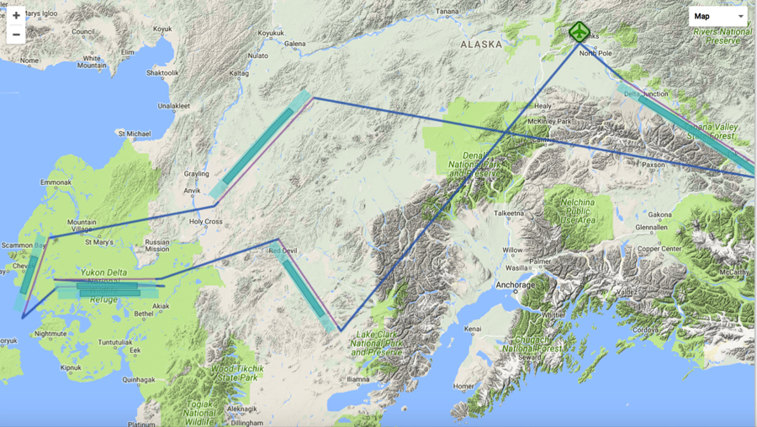
27 May 2017/DOY 147 Yukon – Kuskokwim Delta
Flight Plan 1114 v01: Fairbanks AK (PAFA) – PAFA
https://uavsar.jpl.nasa.gov/cgi-bin/report.pl?planID=PLAN_1114_v01#flightPlan
Data Acquisitions:
Line 1, ID 32607: Acquired 5/26/17
Line 2, ID 27030: YK Delta 1
Line 3, ID 27031: YK Delta 2
Line 4, ID 01811: YK Coast
Line 5, ID 04214: Innoko
Line 6, ID 30203: Acquired 5/26/17
Line 7, ID 25507: Huslia
Line 8, ID 25508: Koyuk
Line 9, ID 03106: Selawik
Line 10, ID 20007: Coldfoot
Lines 7 – 10 added from
Plan 1116
P-band keep-out zone shown in RED
(centered on Clear, AK: 64.29 N, 149.19 W)
25507
25508
03106
20007
30203
04214
01811
27030
27031
32607
5/27/17 flight plan & acquisition segments

Slide 6
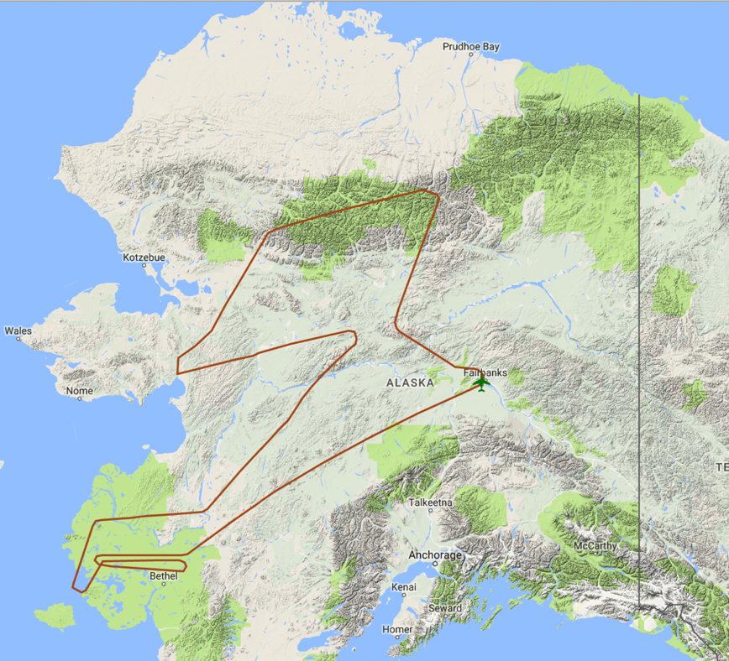
27 May 2017/DOY 147 Yukon – Kuskokwim Delta
Actual Flight Lines
Data Acquisitions:
Line 1, ID 32607: Acquired 5/26/17
Line 2, ID 27030: YK Delta 1
Line 3, ID 27031: YK Delta 2
Line 4, ID 01811: YK Coast
Line 5, ID 04214: Innoko
Line 6, ID 30203: Acquired 5/26/17
Line 7, ID 25507: Huslia
Line 8, ID 25508: Koyuk
Line 9, ID 03106: Selawik
Line 10, ID 20007: Coldfoot
Lines 7 – 10 added from
Plan 1116
03106
20007
25507
25508
04214
01811
27030
27031

Slide 7
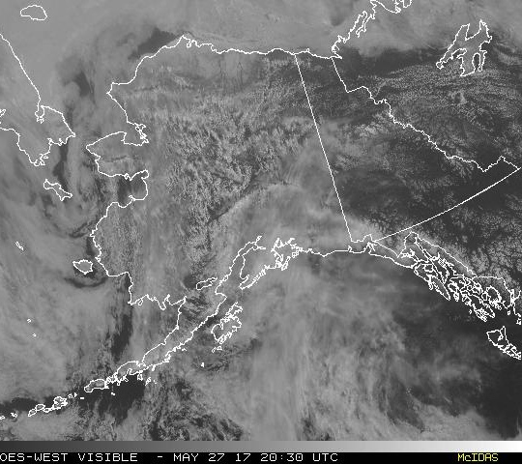
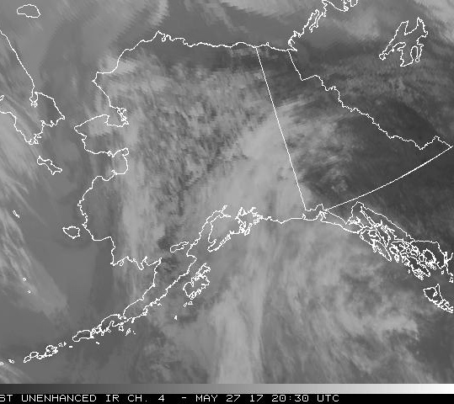
27 May 2017/DOY 147 Yukon – Kuskokwim Delta
GOES-West Vis 2030Z
GOES-West IR4 2030Z
GOES-West Vis (left) and IR (right) show mostly cloudy conditions across Alaska

Slide 8
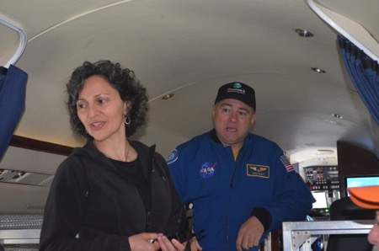
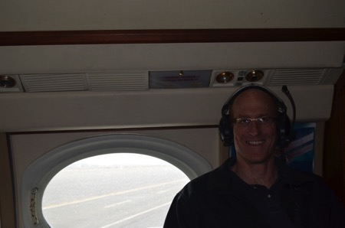
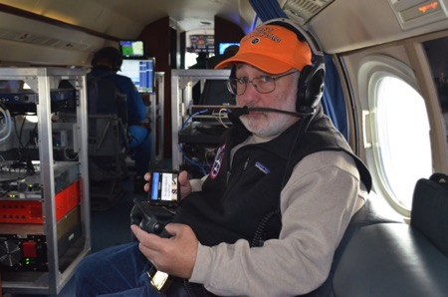
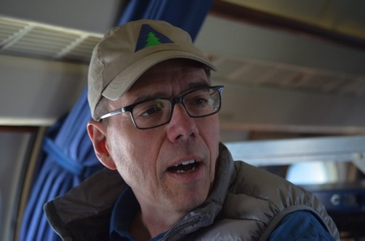
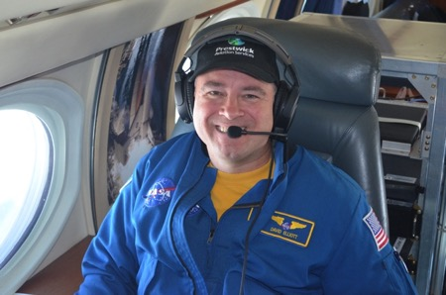
27 May 2017/DOY 147 Yukon – Kuskokwim Delta
Stevens Village
Beaver
In-flight action

Slide 9
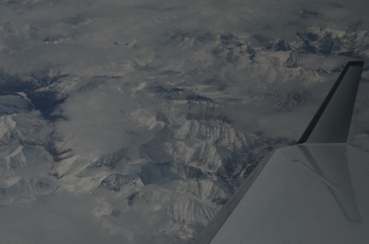
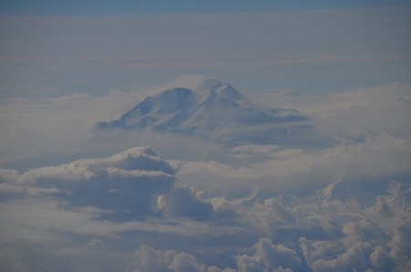
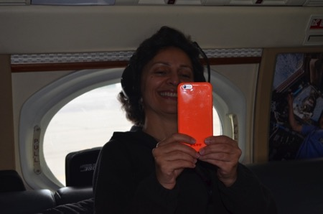
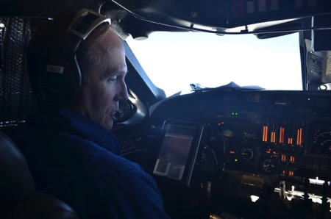
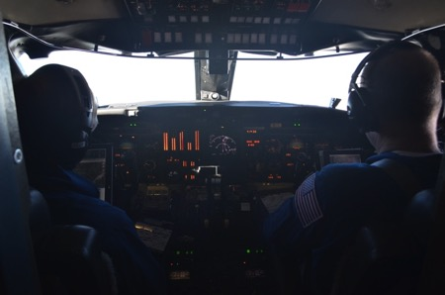
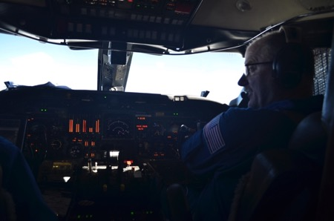
27 May 2017/DOY 147 Yukon – Kuskokwim Delta
Stevens Village
Beaver
Views of Denali and western Alaska

Slide 10
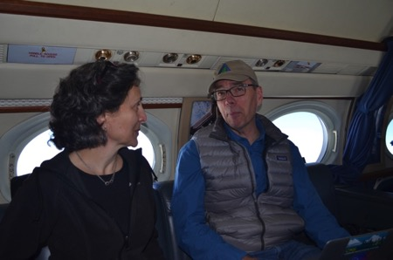
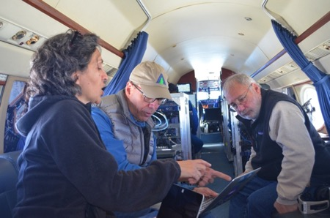
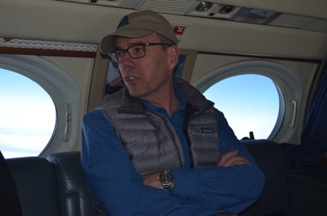
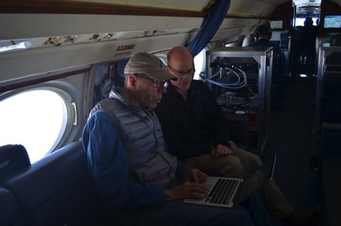
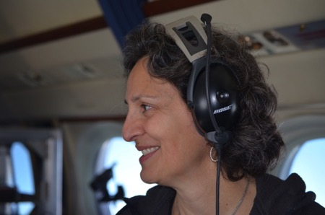
27 May 2017/DOY 147 Yukon – Kuskokwim Delta
Stevens Village
Beaver
Views of Denali and western Alaska

Slide 11
27 May 2017/DOY 147 Yukon – Kuskokwim Delta
A
B
C
D
AirMOSS Quick-look products
A. Line 2, ID 27030: YK Delta 1
B. Line 3, ID 27031: YK Delta 2
C. Line 4, ID 01811: YK Coast
D. Line 5, ID 04214: Innoko
Joanne Shimada, JPL

Slide 12
27 May 2017/DOY 147 Yukon – Kuskokwim Delta
A
B
C
D
AirMOSS Quick-look products
A. Line 7, ID 25507: Huslia
B. Line 8, ID 25508: Koyuk
C. Line 9, ID 03106: Selawik
D. Line 10, ID 20007: Coldfoot
Joanne Shimada, JPL

Slide 13
27 May 2017/DOY 147 Yukon – Kuskokwim Delta
27031
27030
Overlapping segments acquired over YK Delta tundra that burned in 2015
Multiple ABoVE projects are working here to understand the impacts of these recent burns on permafrost degradation, carbon fluxes, and wildlife
Swaths are each approx 12 km x 70 km
Notes:
Quick-look product overlap is not perfect as the images still require additional correction and processing

Slide 14
27 May 2017/DOY 147 Yukon – Kuskokwim Delta
Innoko/04214
Selawik/03106
Notes:
Detailed wetlands images from TOP: the Innoko NWR and BOTTOM: the Selawik NWR. Both feature serpentine rivers and myriad lakes, fens and bogs. AirMOSS P-band radar will help ABoVE researchers understand the differences in the permafrost active layer, soil moisture, and vegetation in these ecosystems

